Slide 1
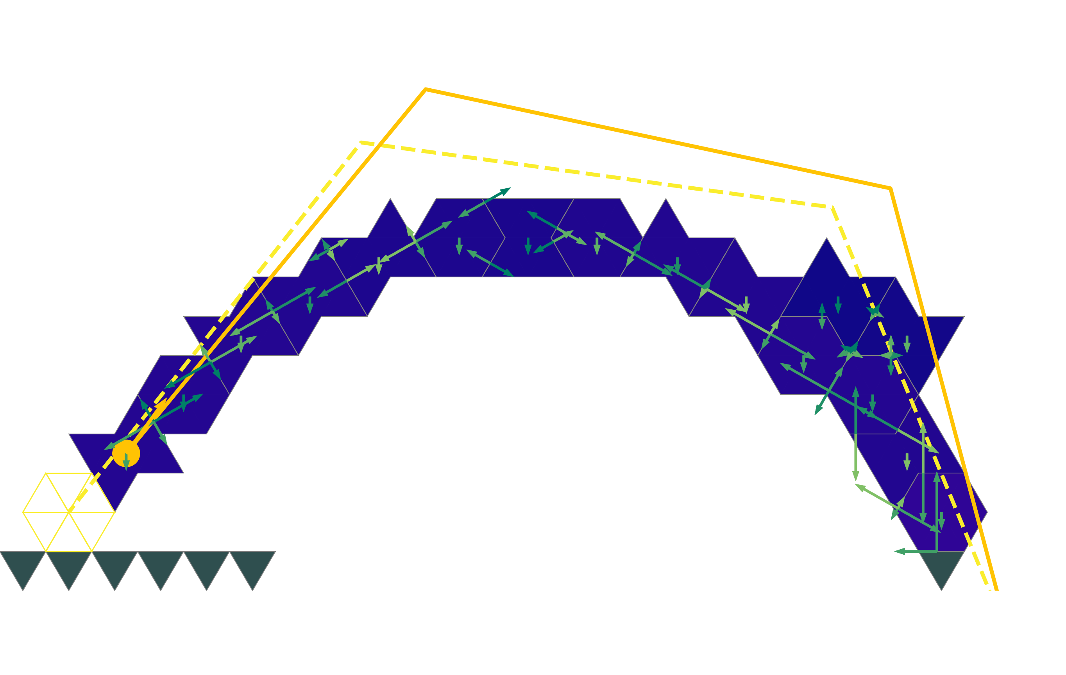
Multi-agent reinforcement learning
For construction of a spanning structure
Gabriel Vallat

Slide 2
What?
The construction of the spanning self-supporting structure

Slide 3
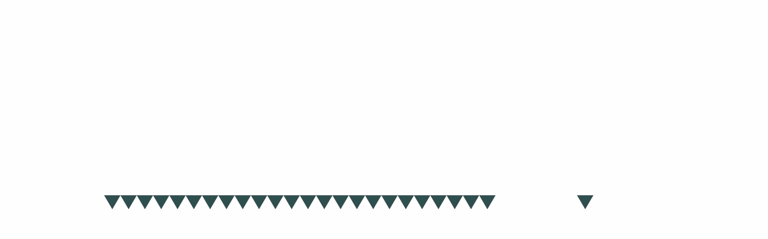
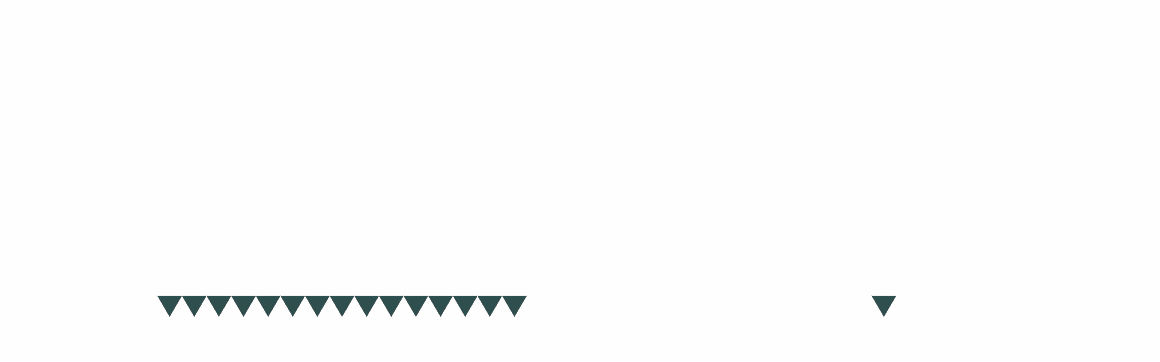
The project
Use a static simulator
Train agents to build a spanning self-supporting structure

Slide 4

Self-supporting structure
Uses gravity and friction
Only uses compressive forces
Allows the reuse of bricks

Slide 5
Self-supporting structure
Cross vault
Armadillo vault
Roman arch
Dome
Flying buttress
Automated construction

Slide 6
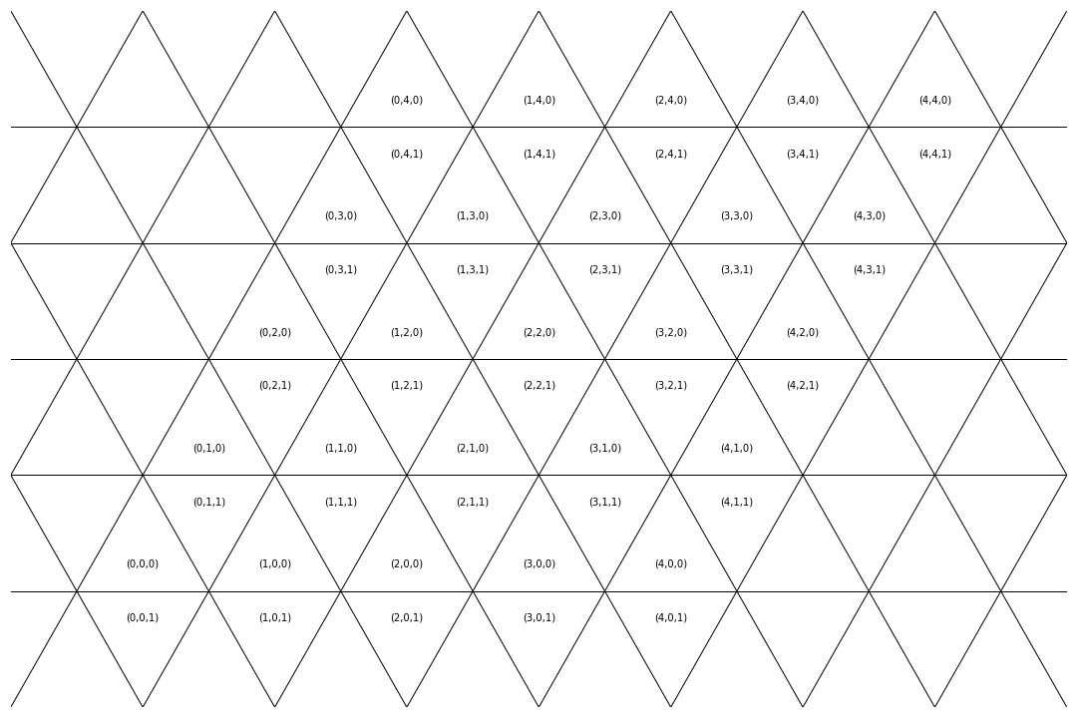
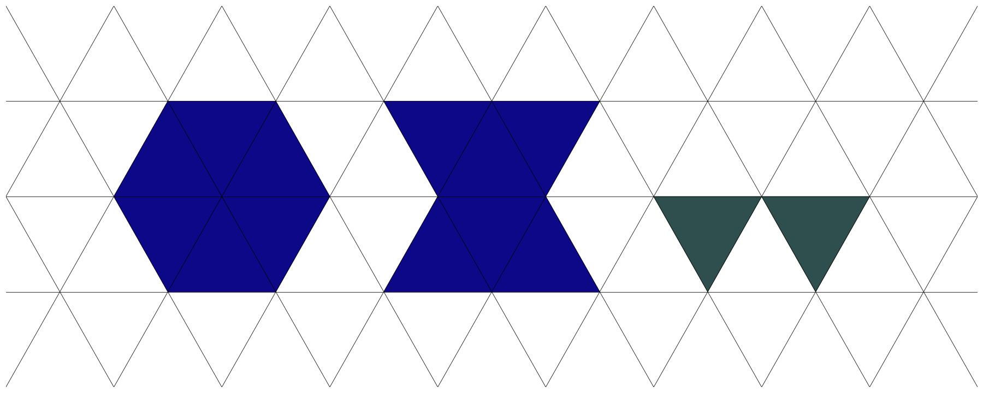
Setup
Discrete 2D setup
Isometric grid
2 types of blocks
Grounds of different length

Slide 7
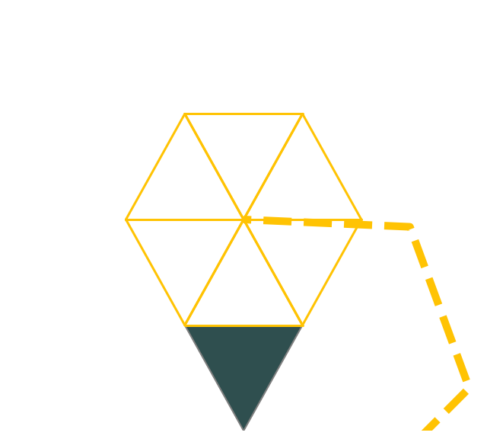

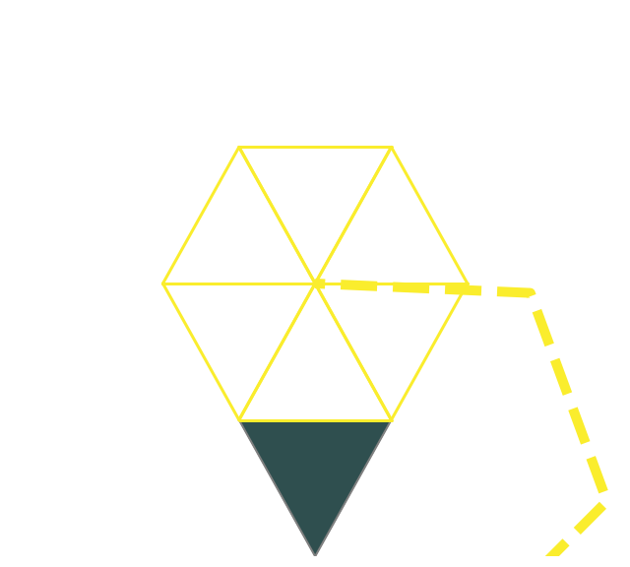

Setup
2 actions that each robot can take:
Hold an existing block
Place a new block

Slide 8
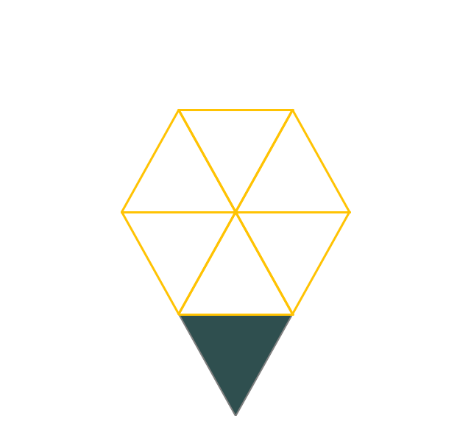

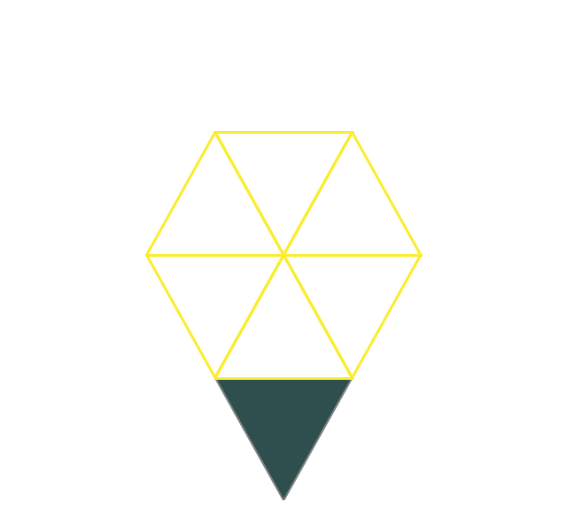

Setup
2 actions that each robot can take:
Hold an existing block
Place a new block

Slide 9
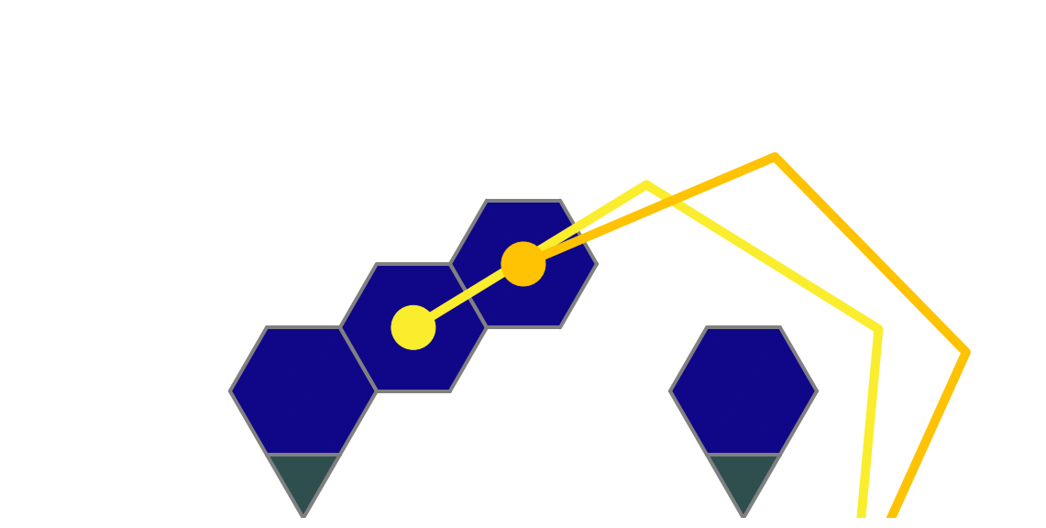
Task
Build a stable structure that connects two separate grounds

Slide 10
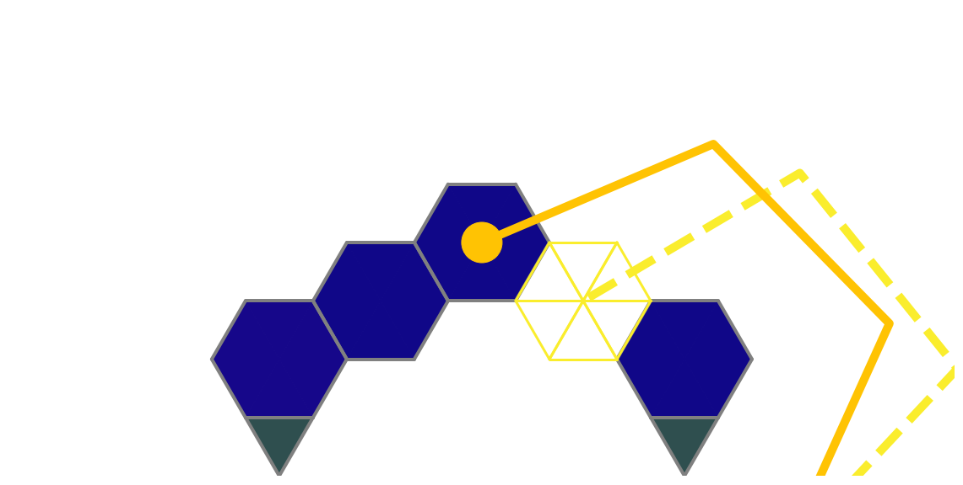
Task
Build a stable structure that connects two separate grounds

Slide 11
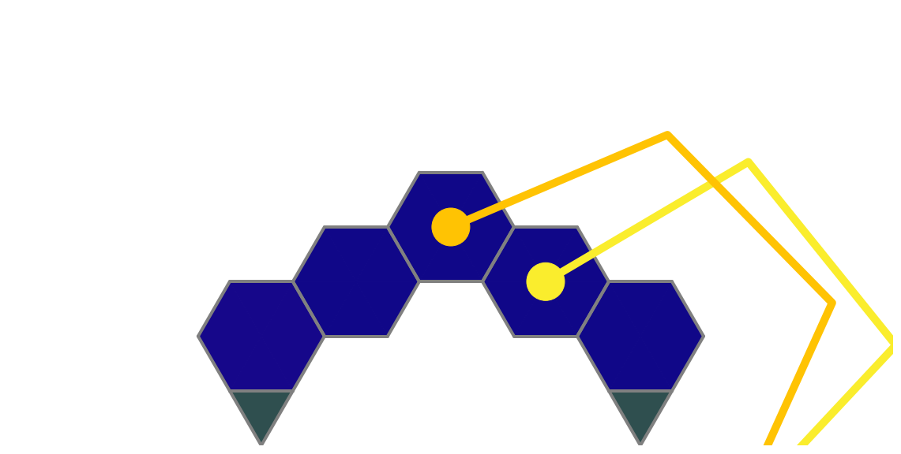
Task
Build a stable structure that connects two separate grounds

Slide 12
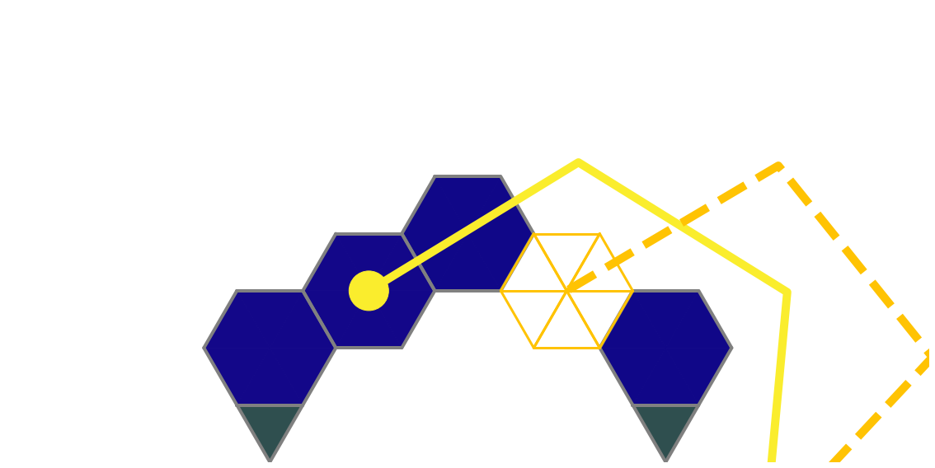
Task
Build a stable structure that connects two separate grounds

Slide 13
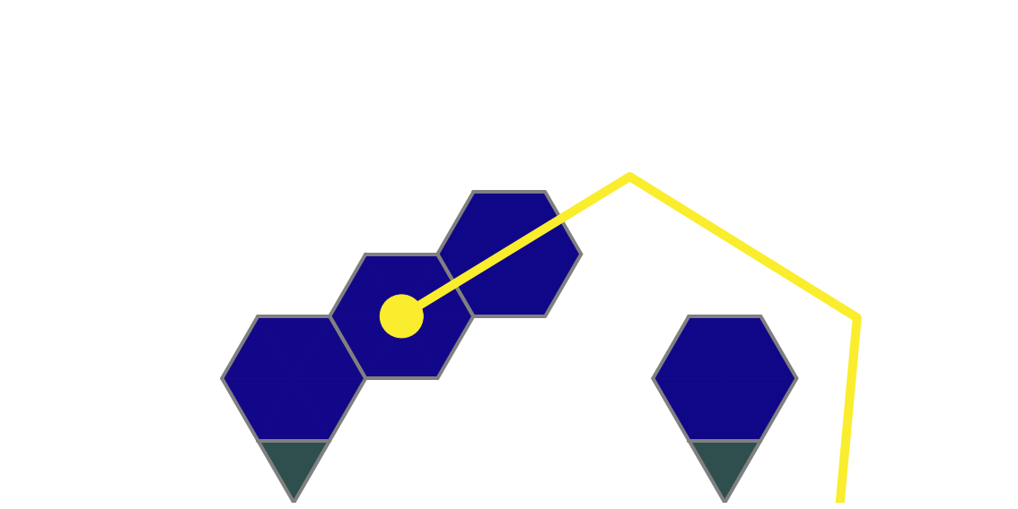
Task
Build a stable structure that connects two separate grounds

Slide 14
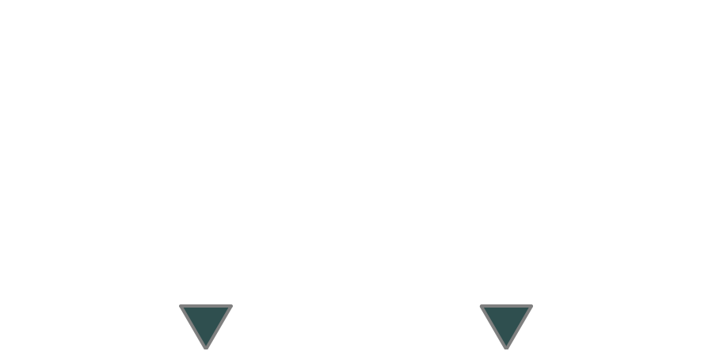
Task
Build a stable structure that connects two separate grounds

Slide 15
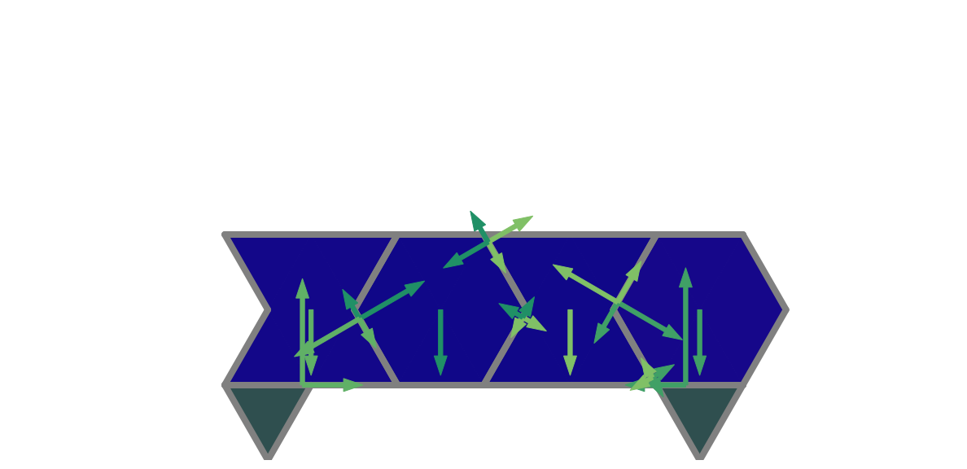
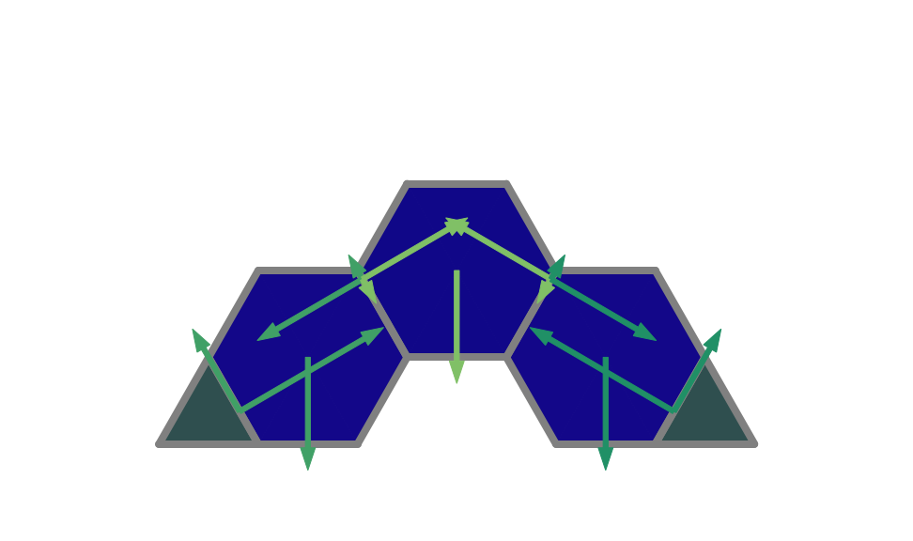
Physics Simulator
Check the stability of each blocks
Use a linear program formulation

Slide 16
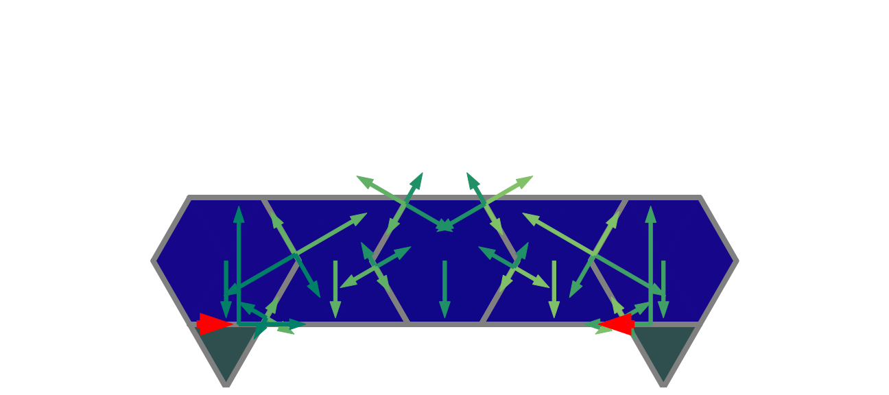
Physics Simulator
Constraints:
Newton’s first law
Compressive forces
Static friction

Slide 17
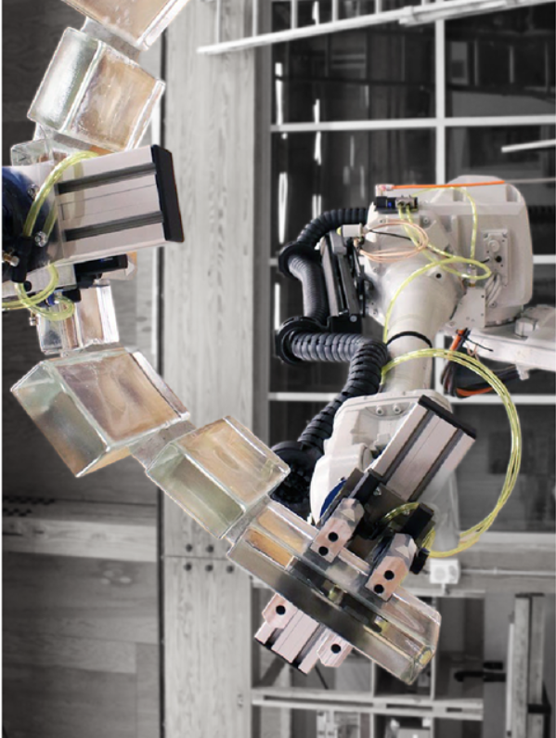
How
Single agent reinforcement learning
Multi-agent reinforcement learning

Slide 18
RL
An agent has to learn to achieve a task
What does learning mean?
Produce a good policy

Slide 19

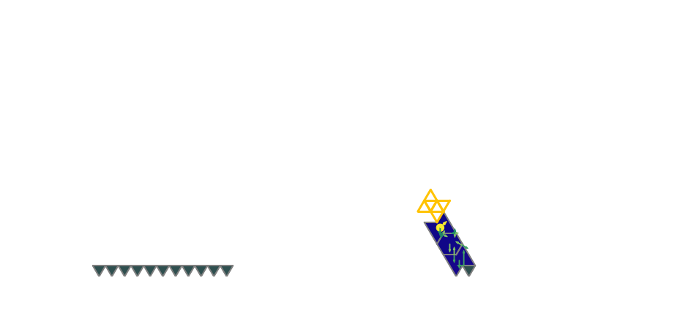
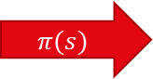
RL
An agent has to learn to achieve a task
What does learning mean?
Produce a good policy
$$π(s)$$

Slide 20
RL
An agent has to learn to achieve a task
What does learning mean?
Produce a good policy

Slide 21
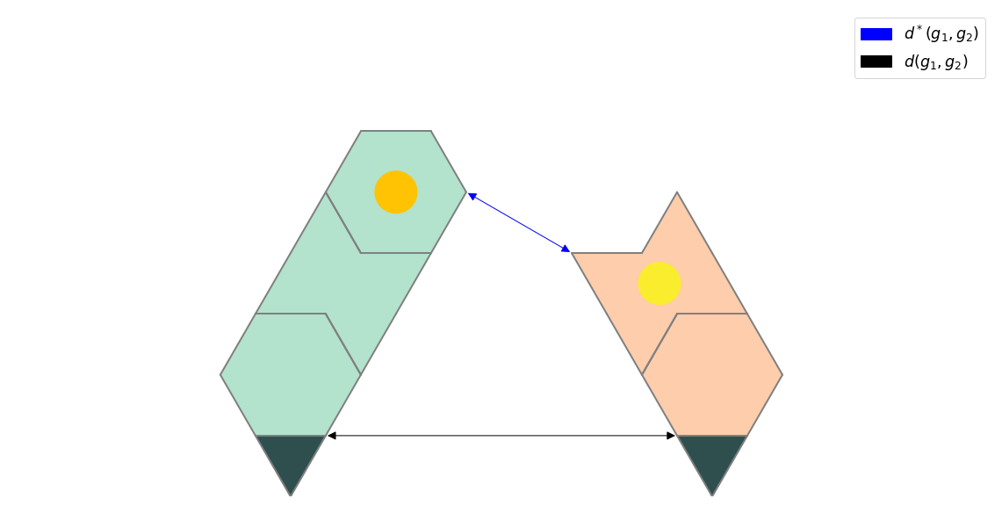
Rewards
Main rewards:
Collapse cost
Success reward
Helper rewards:
Smaller distance in free air between the grounds
More sides in contact
Less useless blocks placed

Slide 22
RL
An agent has to learn to achieve a task
What does learning mean?
Produce a good policy
How to learn?
By remembering mistakes that were done or good examples
By continuously trying to improve the current method

Slide 23
RL
An agent has to learn to achieve a task
What does learning mean?
Produce a good policy
How to learn?
By remembering mistakes that were done or good examples
By continuously trying to improve the current method

Slide 24
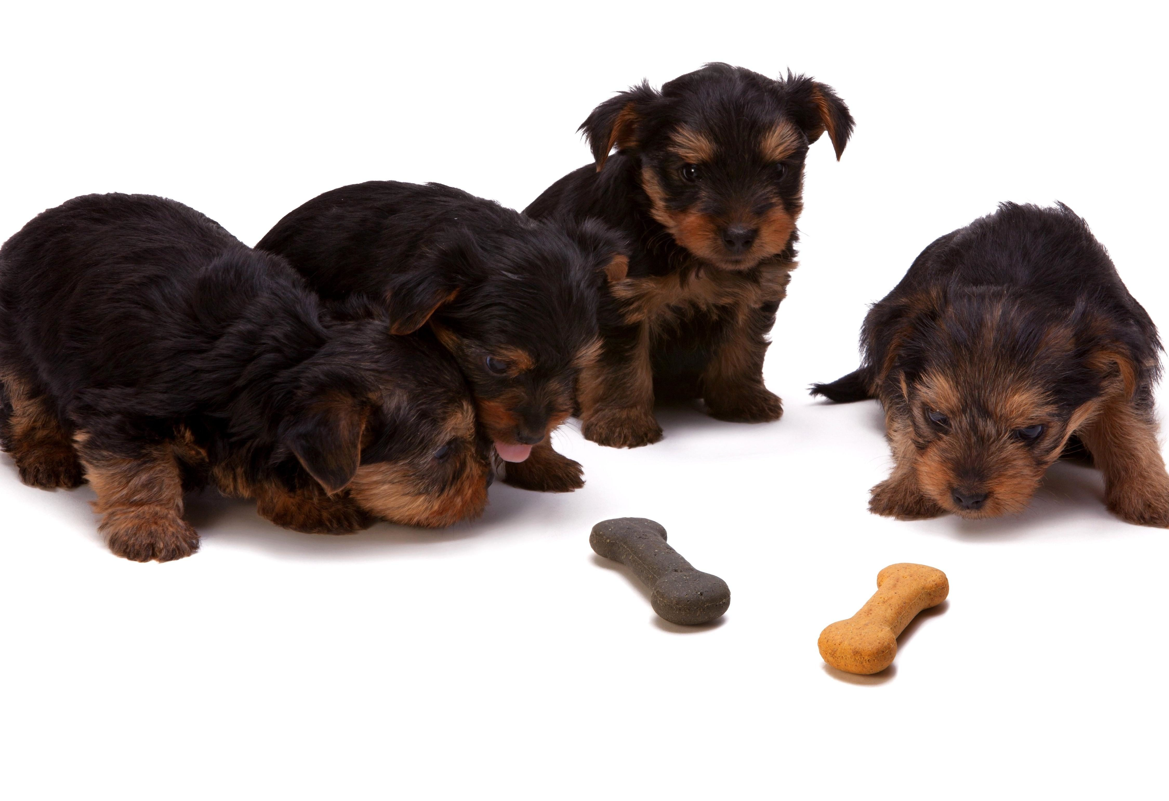
How to learn?
With a single agent
Reinforcement learning

Slide 25
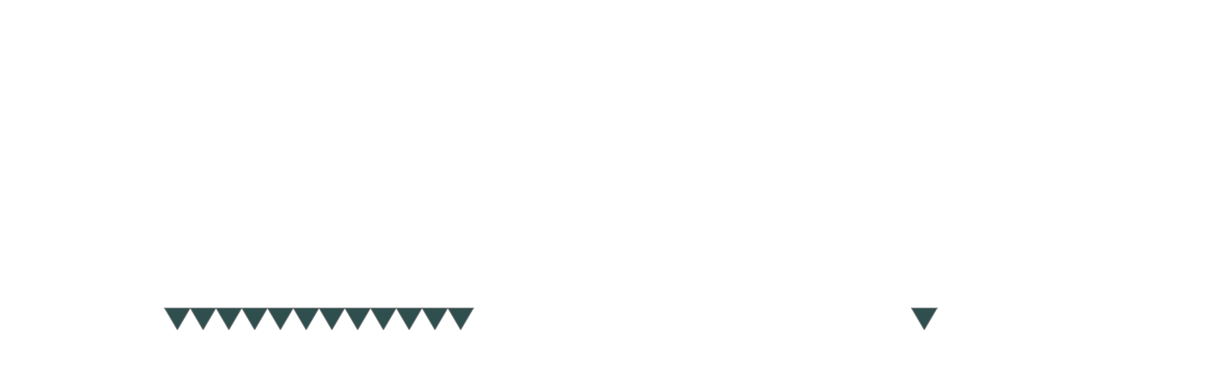
Task
Link a starting point to a target
Separated by a random gap

Slide 26
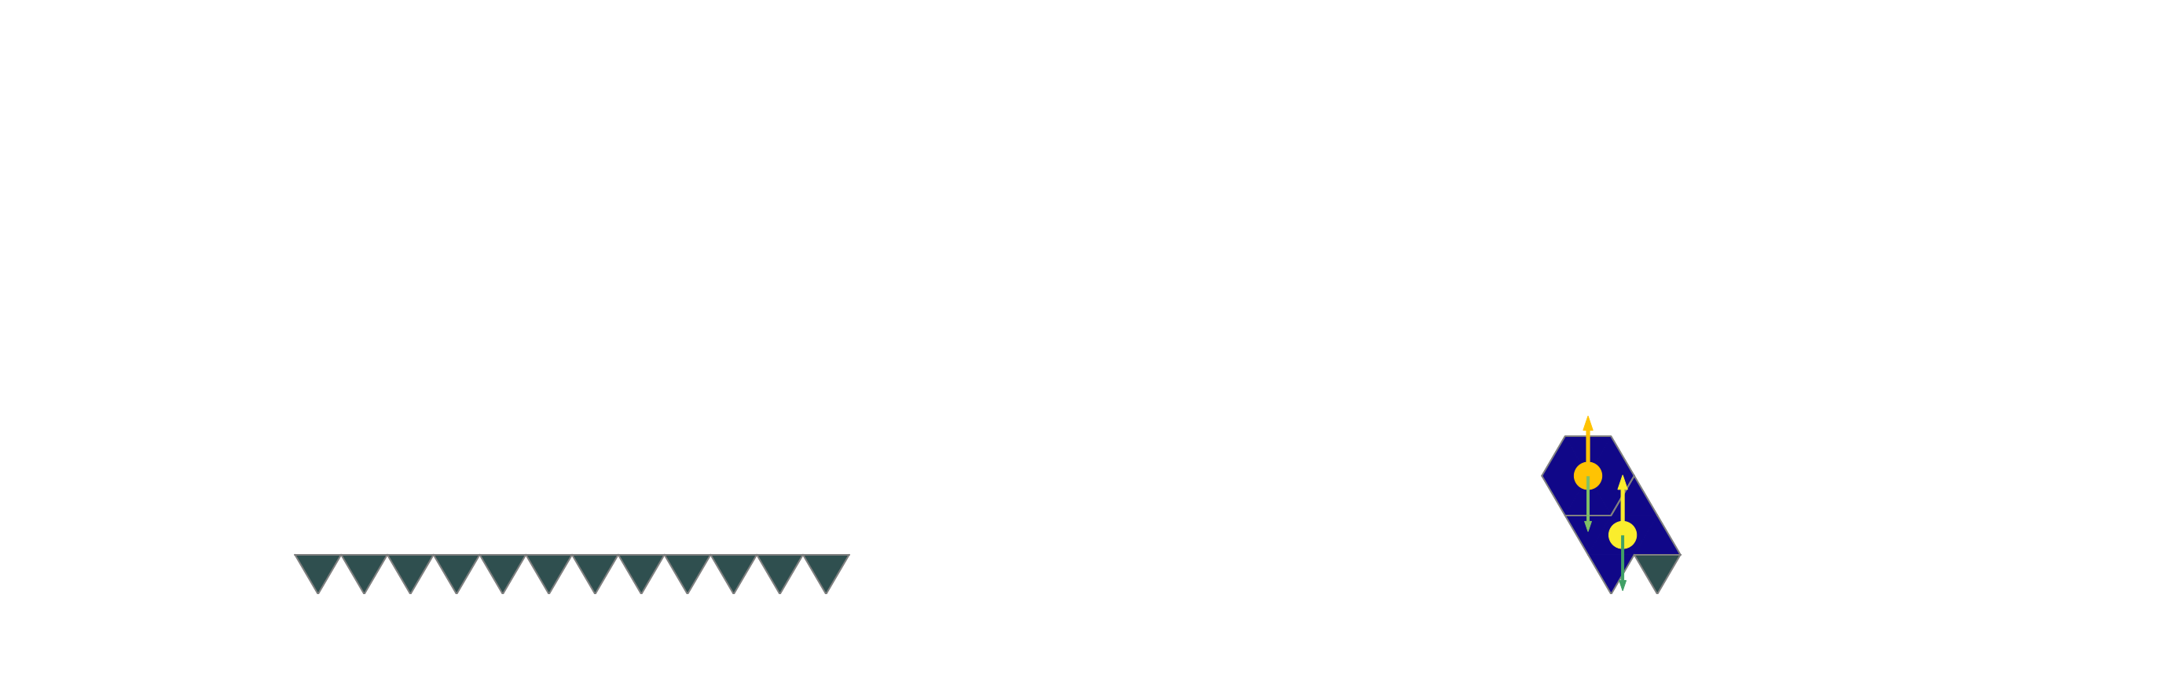
Task
Link a starting point to a target
Separated by a random gap
One agent controls two arms

Slide 27
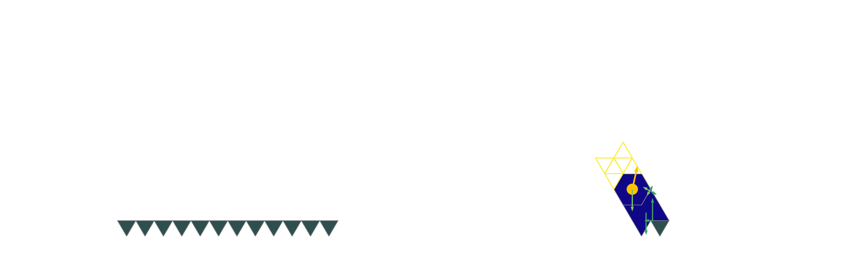
Task
Link a starting point to a target
Separated by a random gap
One agent controls two arms
Only possible to place a block on the last one

Slide 28
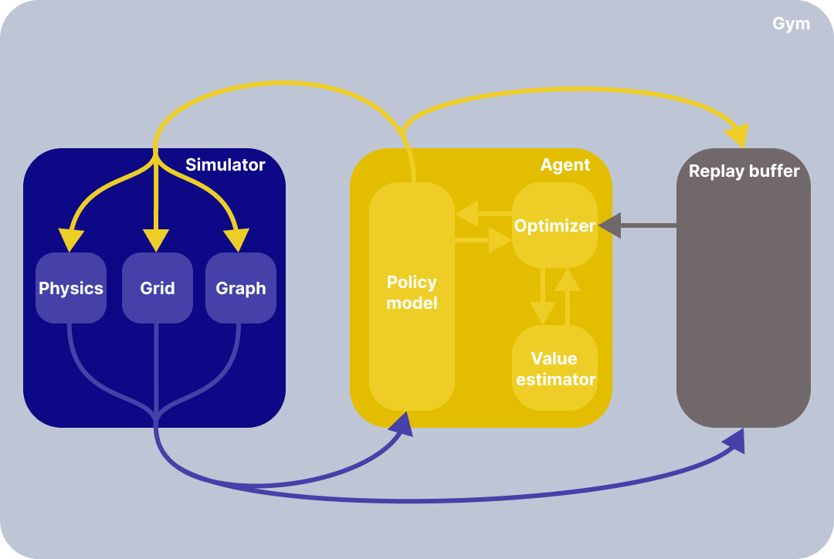
RL
Actor-critic architecture:

Slide 29
RL
Actor-critic architecture:
Explore by using entropy
Soft actor-critic (SAC)
Learn by using surprise
Advantage actor-critic (A2C)

Slide 30
Exploration
How to chose an action?
Always pick the best one

Slide 31
Exploration
Used by A2C
How to chose an action?
Pick the best one 90% of the time

Slide 32
Exploration
How to chose an action?
Pick the action proportionally to its value

Slide 33
Exploration
How to chose an action?
Pick the action proportionally to its value
Necessary to incentivise the entropy
No entropy

Slide 34
Exploration
How to chose an action?
Pick the action proportionally to its value
Necessary to incentivise the entropy
Maximum entropy

Slide 35
Exploration
Used by SAC
How to chose an action?
Pick the action proportionally to its value
Necessary to incentivise the entropy
Intermediate entropy

Slide 36
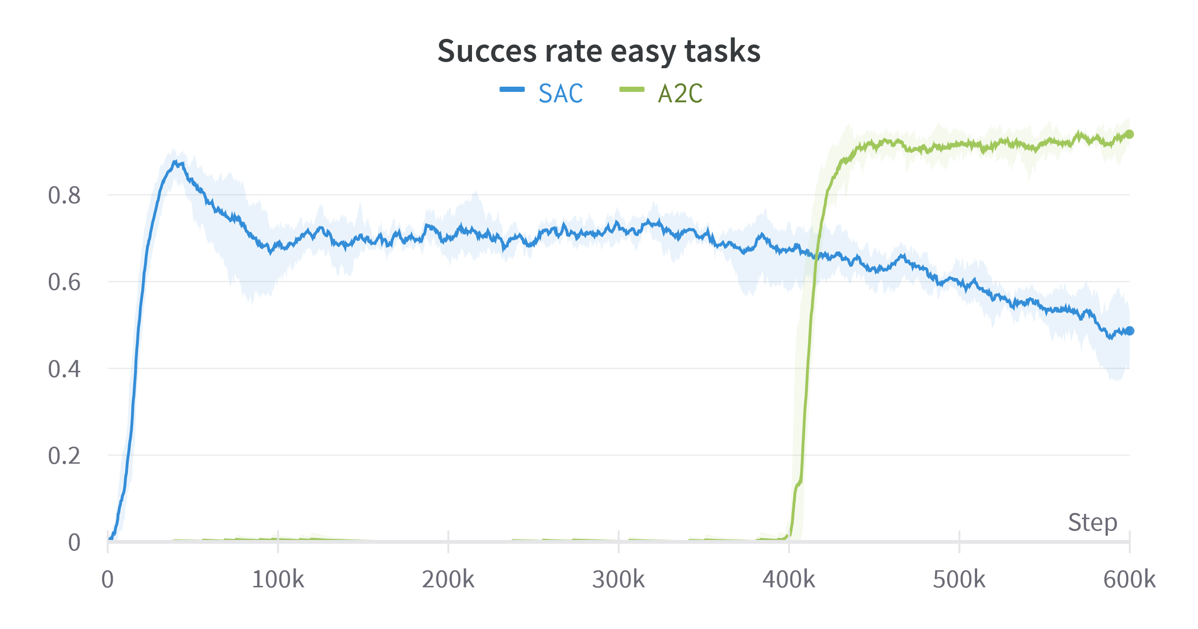
Exploration
2 algorithms
A2C
Uses ε-greedy policy
SAC
Uses softmax + entropy bonus

Slide 37
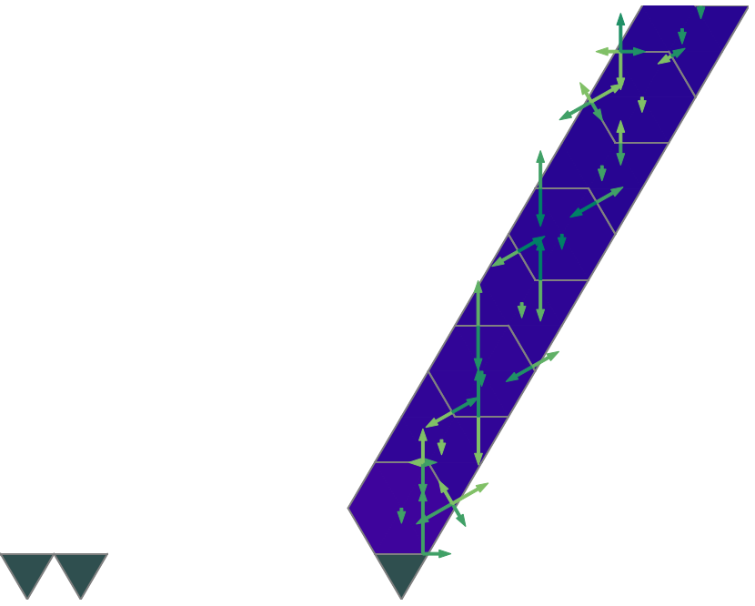
Exploration
2 algorithms
A2C
Uses ε-greedy policy
SAC
Uses softmax + entropy bonus

Slide 38
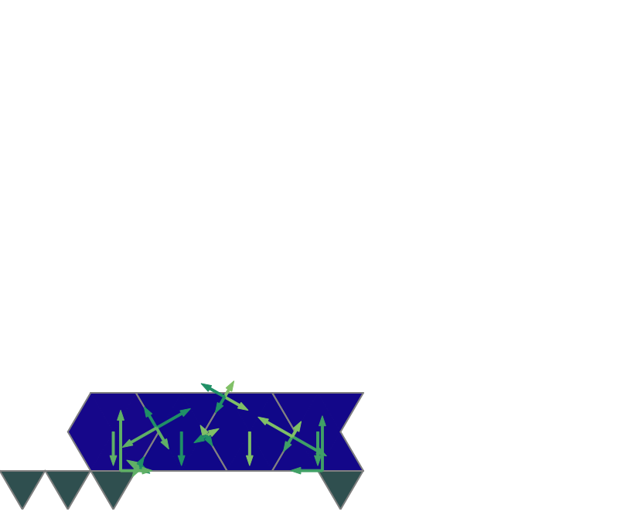
Exploration
2 algorithms
A2C
Uses ε-greedy policy
SAC
Uses softmax + entropy bonus

Slide 39
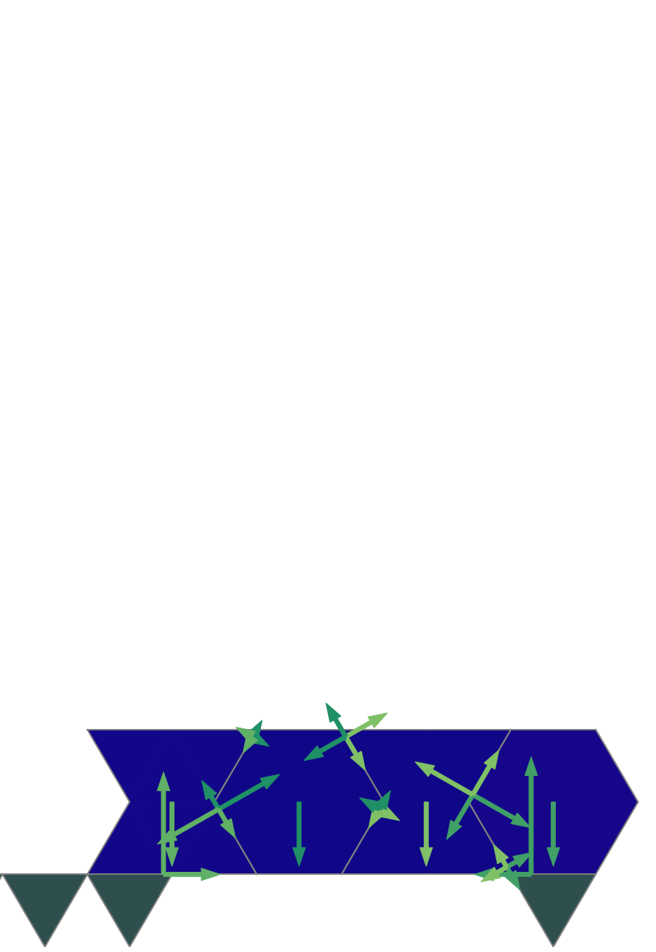
Exploration
2 algorithms
A2C
Uses ε-greedy policy
SAC
Uses softmax + entropy bonus

Slide 40
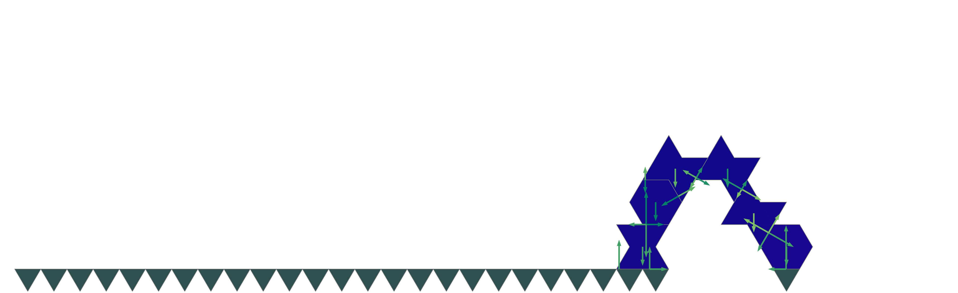
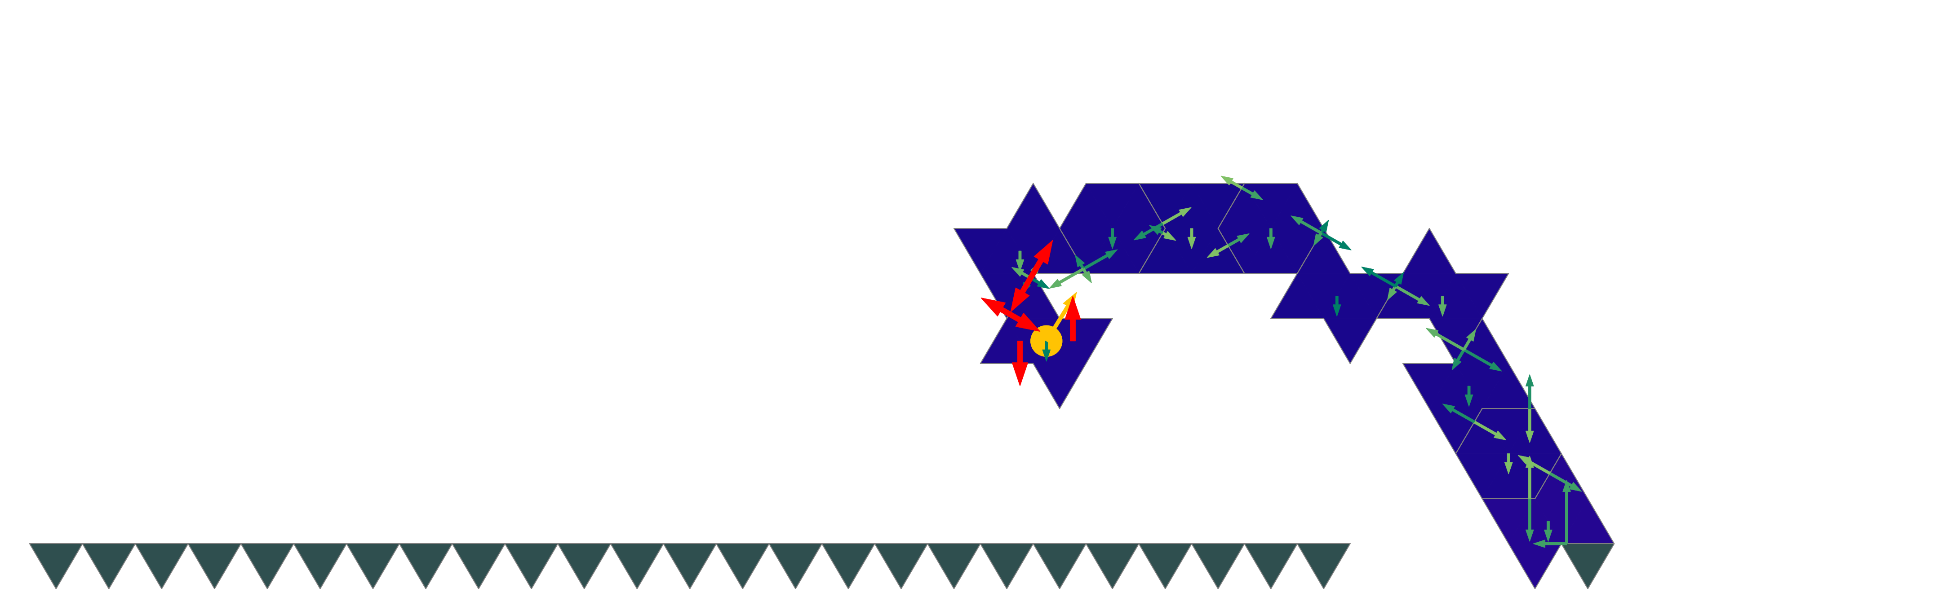
Exploration
2 algorithms
A2C
Uses ε-greedy policy
SAC
Uses softmax + entropy bonus

Slide 41
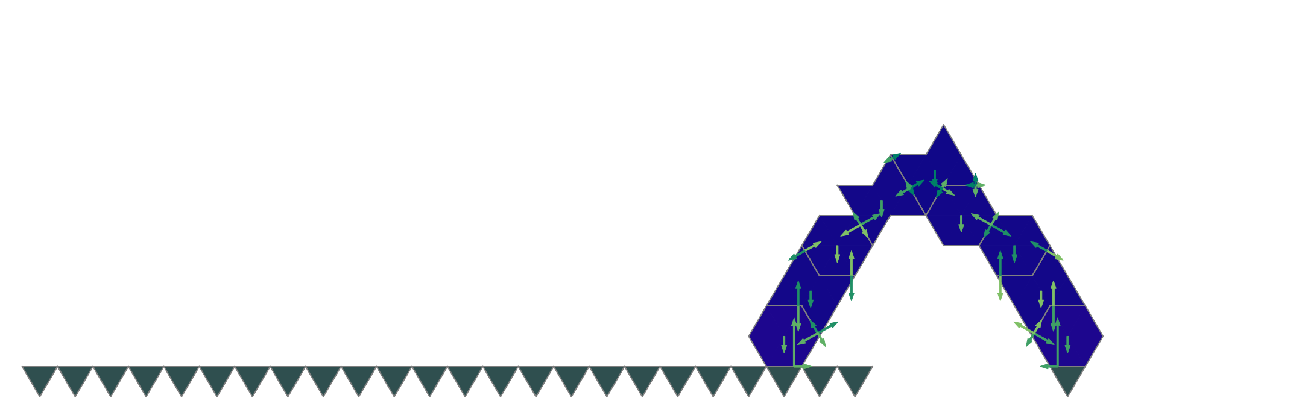
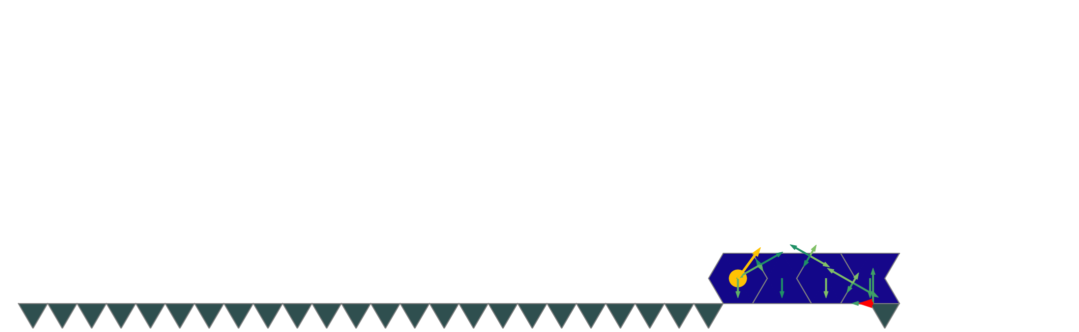
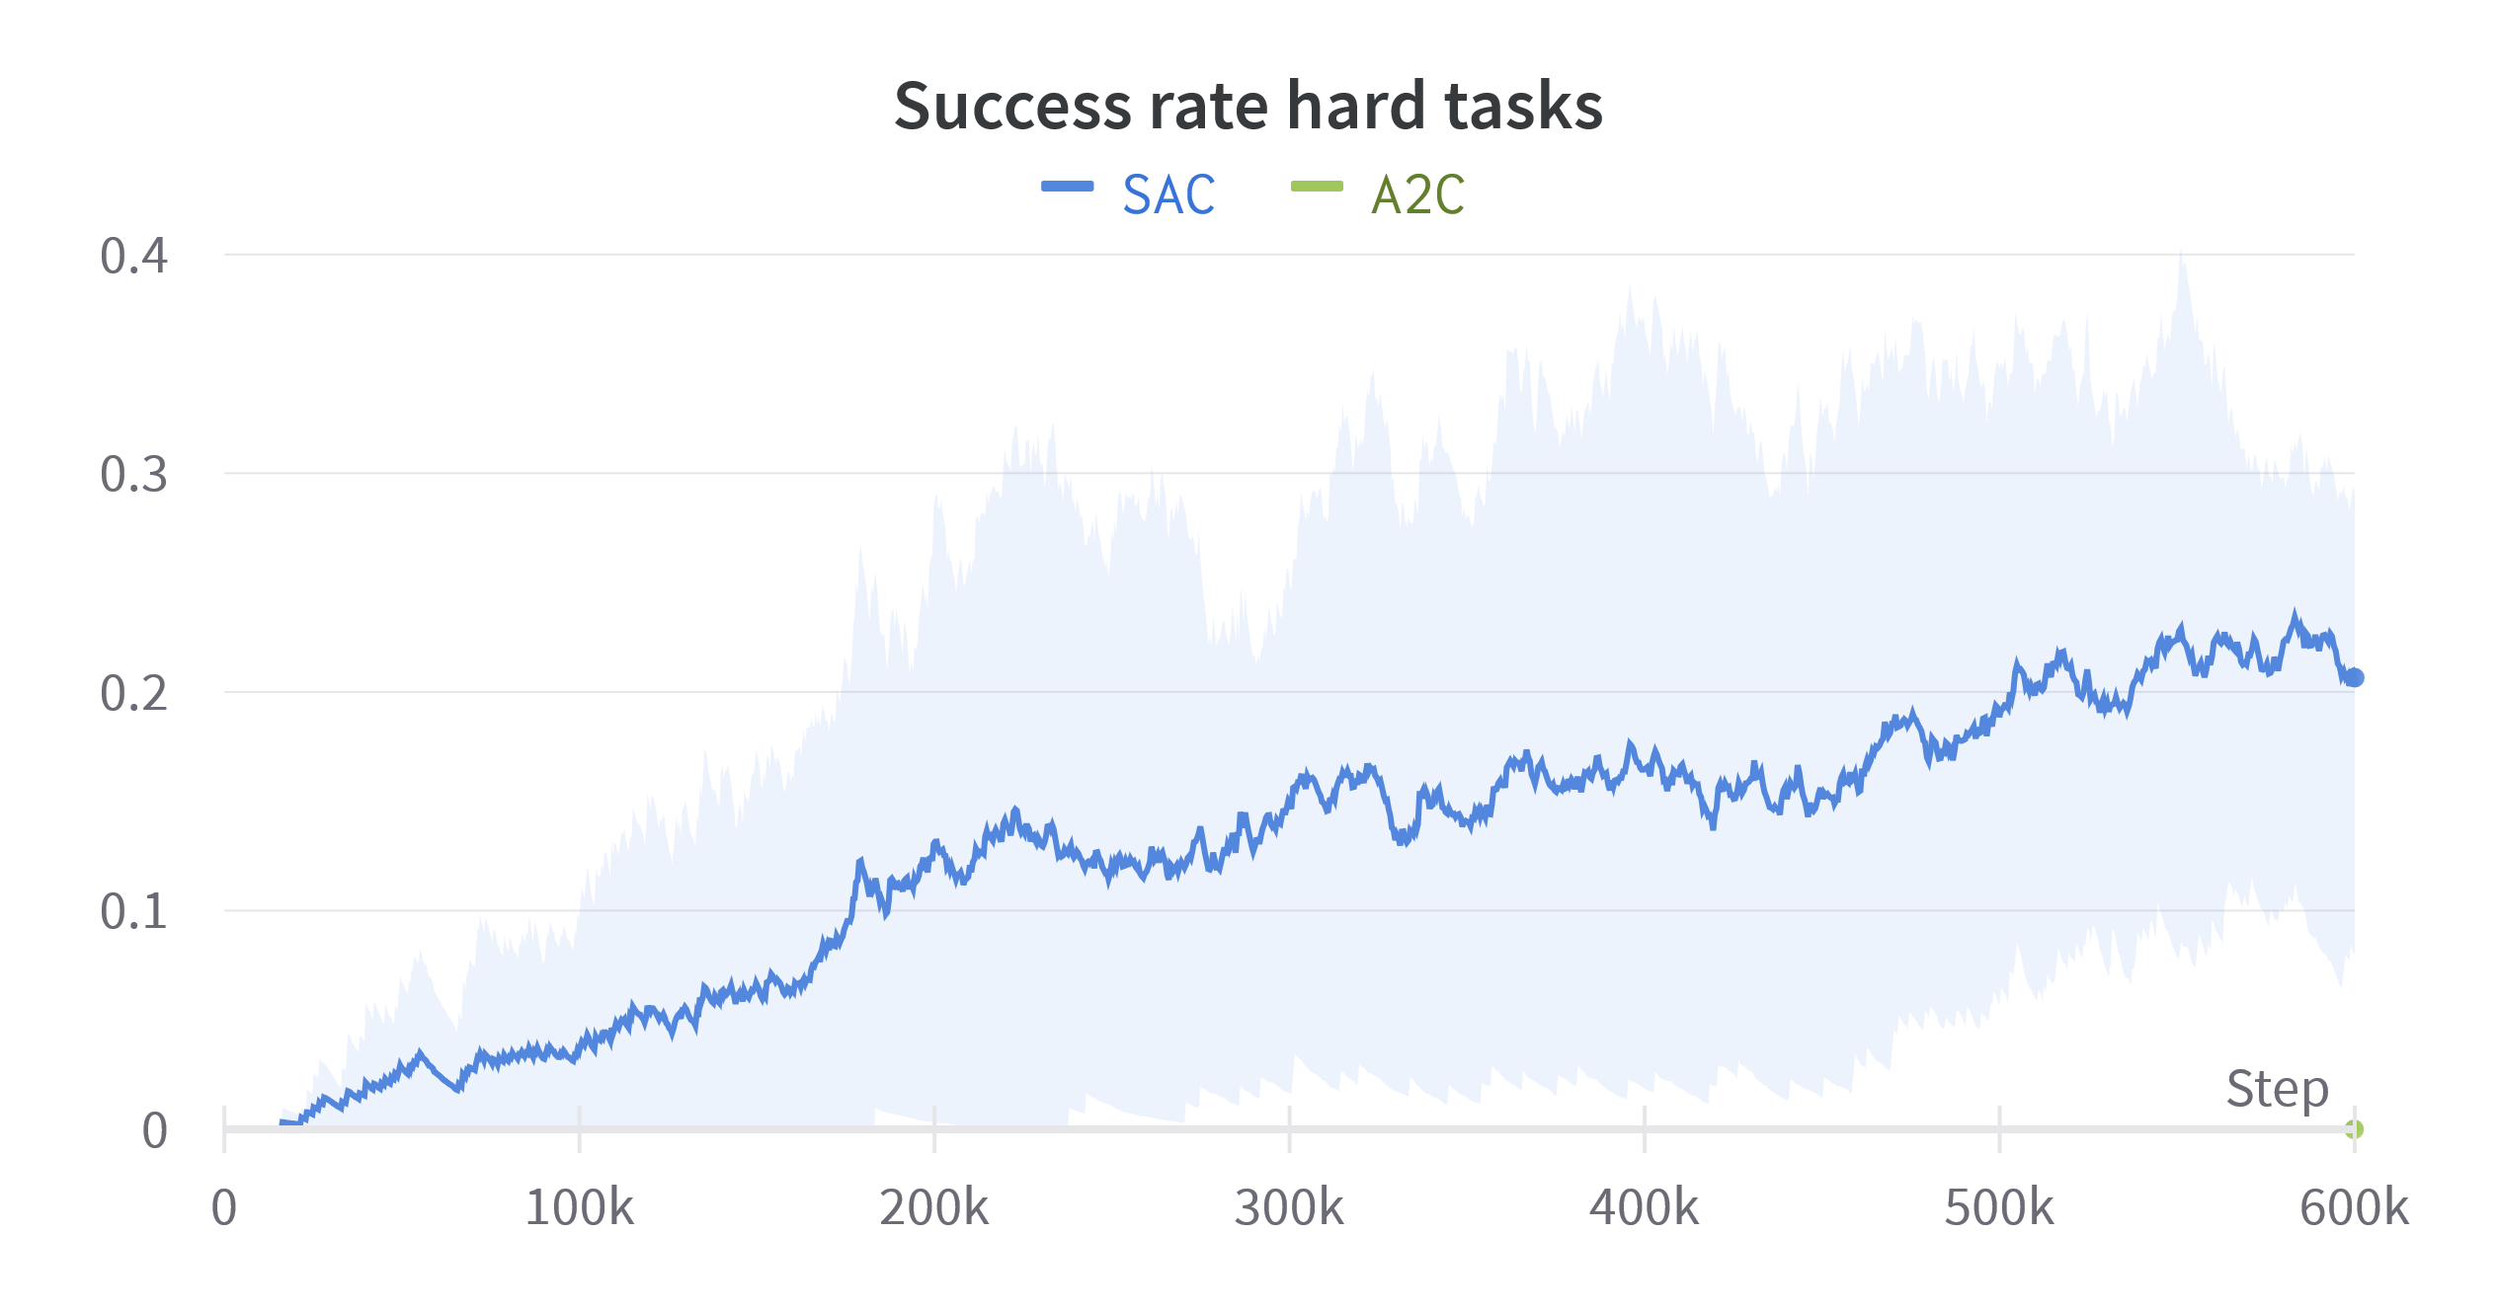
Exploration
2 algorithms
A2C
Uses ε-greedy policy
SAC
Uses softmax + entropy bonus

Slide 42
Exploration
2 algorithms
A2C
Uses ε-greedy policy
SAC
Uses softmax + entropy bonus

Slide 43
How to cooperate?
With multiple agents
Multi-agent reinforcement learning

Slide 44
MARL
When using multiple agents
Centralized training:
A supervisor considers all agents at the same time, producing all of their actions.
Only the supervisor is learning
Single agent
Multi-agent
Centralized training

Slide 45
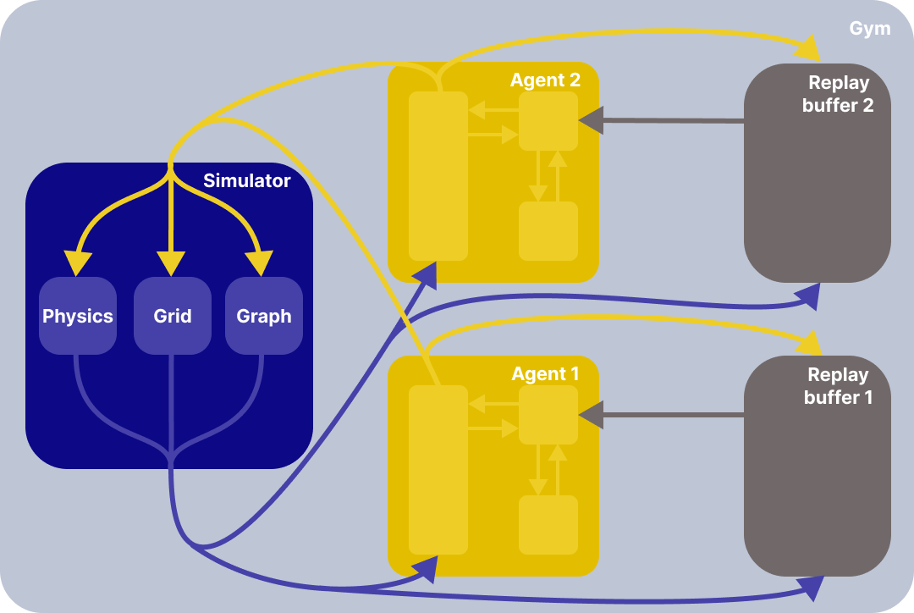
MARL
When using multiple agents
Distributed training

Slide 46
Centralized vs distributed
Task:
Bridge the gap
Gap width1
Gap width 2
Gap width 3
Gap width 5

Slide 47
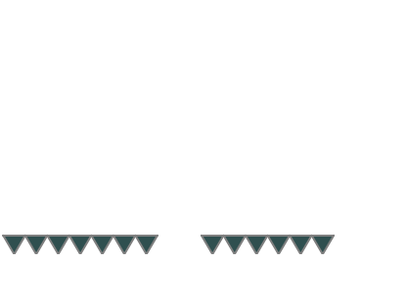
Centralized vs distributed
Task:
Bridge the gap
Distributed agents:
Act simultaneously
Share reward
Can either wait or place a new block

Slide 48
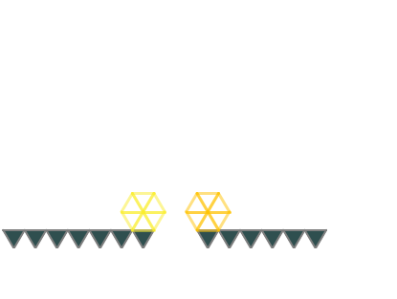
Centralized vs distributed
Task:
Bridge the gap
Distributed agents:
Act simultaneously
Share reward
Can either wait or place a new block

Slide 49
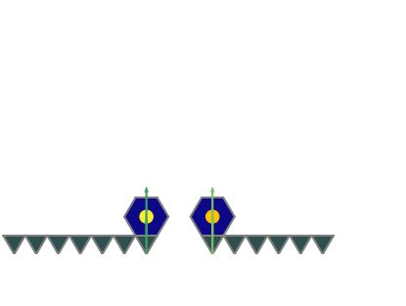
Centralized vs distributed
Task:
Bridge the gap
Distributed agents:
Act simultaneously
Share reward
Can either wait or place a new block

Slide 50
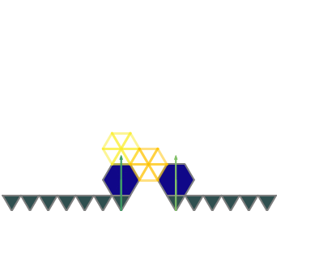
Centralized vs distributed
Task:
Bridge the gap
Distributed agents:
Act simultaneously
Share reward
Can either wait or place a new block

Slide 51
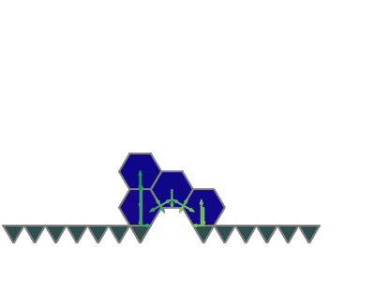
Centralized vs distributed
Task:
Bridge the gap
Distributed agents:
Act simultaneously
Share reward
Can either wait or place a new block

Slide 52
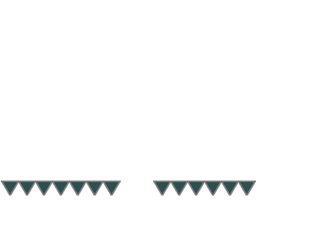
Centralized vs distributed
Task:
Bridge the gap
Distributed agents:
Act simultaneously
Share reward
Can either wait or place a new block
Centralized agent:
Act sequentially
Must always place a new block

Slide 53
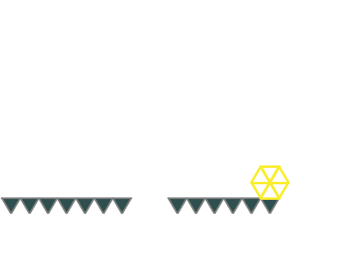
Centralized vs distributed
Task:
Bridge the gap
Distributed agents:
Act simultaneously
Share reward
Can either wait or place a new block
Centralized agent:
Act sequentially
Must always place a new block

Slide 54
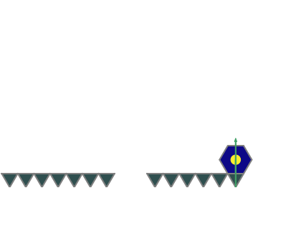
Centralized vs distributed
Task:
Bridge the gap
Distributed agents:
Act simultaneously
Share reward
Can either wait or place a new block
Centralized agent:
Act sequentially
Must always place a new block

Slide 55
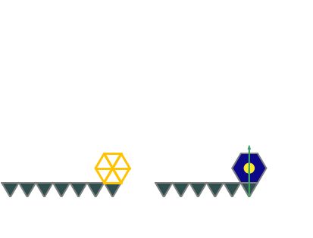
Centralized vs distributed
Task:
Bridge the gap
Distributed agents:
Act simultaneously
Share reward
Can either wait or place a new block
Centralized agent:
Act sequentially
Must always place a new block

Slide 56
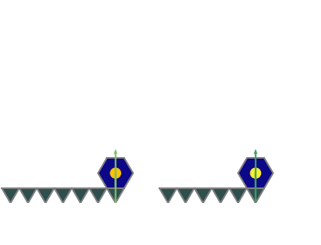
Centralized vs distributed
Task:
Bridge the gap
Distributed agents:
Act simultaneously
Share reward
Can either wait or place a new block
Centralized agent:
Act sequentially
Must always place a new block

Slide 57
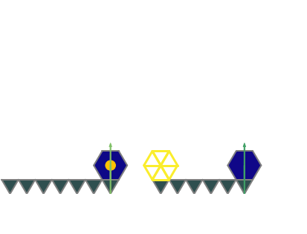
Centralized vs distributed
Task:
Bridge the gap
Distributed agents:
Act simultaneously
Share reward
Can either wait or place a new block
Centralized agent:
Act sequentially
Must always place a new block

Slide 58
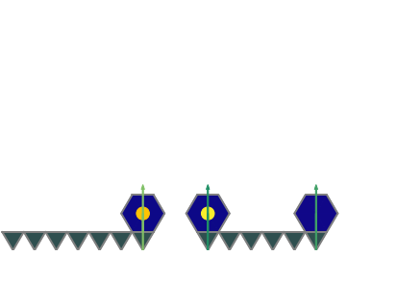
Centralized vs distributed
Task:
Bridge the gap
Distributed agents:
Act simultaneously
Can either wait or place a new block
Centralized agent:
Act sequentially
Must always place a new block

Slide 59
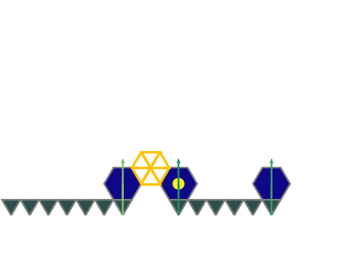
Centralized vs distributed
Task:
Bridge the gap
Distributed agents:
Act simultaneously
Share reward
Can either wait or place a new block
Centralized agent:
Act sequentially
Must always place a new block

Slide 60

Centralized vs distributed
Task:
Bridge the gap
Distributed agents:
Act simultaneously
Share reward
Can either wait or place a new block
Centralized agent:
Act sequentially
Must always place a new block

Slide 61


Results

Slide 62




Results
Distributed
Centralized

Slide 63




Results
Distributed
Centralized

Slide 64
Conclusion

Slide 65
Challenges
Building a spanning structure is vague
Formal task description
Reward design
What is a failure?
MARL takes time
Often takes more than a day to train a single agent
Many unpredicted local minima
Only state of the art method achieves a good performance

Slide 66










Success
Building a variety of small structures

Slide 67






Success
Building large spanning structures

Slide 68

Take aways
Fully distributed training works poorly on tasks that requires a tight coordination
Centralized training is better for this task
SAC searches efficiently the best policy
SAC allows to modify the structure midway
Good starting point to bridge the simulation to real world gap

Slide 69

Take aways
Fully distributed training works poorly on tasks that requires a tight coordination
Centralized training is better for this task
SAC searches efficiently the best policy
SAC allows to modify the structure midway
Good starting point to bridge the simulation to real world gap

Slide 70

Take aways
Fully distributed training works poorly on tasks that requires a tight coordination
Centralized training is better for this task
SAC searches efficiently the best policy
SAC allows to modify the structure midway
Good starting point to bridge the simulation to real world gap

Slide 71
Next steps
Toward a more real environment:
Continuous domain
Sensor feedback
Noise
Real environment
Toward more agents:
Setups between fully centralized and fully distributed
Leverage game theoretical approaches
Toward other types of tasks:
Obstacles
Unique blocks

Slide 72




Thank you
Questions?

Slide 73

Success
Building large spanning structures

Slide 74




Failures

Slide 75

Off policy vs on policy

Slide 76

Off policy vs on policy

Slide 77

Off policy vs on policy

Slide 78

Off policy vs on policy

Slide 79

Off policy vs on policy

Slide 80

Off policy vs on policy

Slide 81

Off policy vs on policy

Slide 82
Off policy vs on policy

Slide 83
Off policy vs on policy

Slide 84

Entropy
$H\left(π(s)\right)=−\sum_{a}{π{\left(s\right)}_{a}\log\left(π{\left(s\right)}_{a}\right)=}E[−log⁡(π\left(s\right))]$
$\max\left(H\left(π\left(s\right)\right)\right)=−\log\left(\left|𝒜\right|\right)$
When $π\left(s\right)=𝒰(𝒜)$
$\min\left(H\left(π\left(s\right)\right)\right)=0$
When $π\left(s\right)=δ(a−a_{i})$ (deterministic policy)

Slide 85



Entropy bonus
$H\left(π\right)=−\sum_{s}{P\left(s\right)\sum_{a}{π{\left(s\right)}_{a}\log\left(π{\left(s\right)}_{a}\right)=}}E_{s,a}[−log⁡(π(s))]$
Modified reward:
$r^{′}\left(s,a\right)=r\left(s,a\right)+αH(π)$
Dynamic $α$:
Optimize alpha so that it grows when $H\left(π\right)<H_{t}$ and decays when $H\left(π\right)>H_{t}$

Slide 86


Entropy bonus
$H\left(π\right)=−\sum_{s}{P\left(s\right)\sum_{a}{π{\left(s\right)}_{a}\log\left(π{\left(s\right)}_{a}\right)=}}E_{s,a}[−log⁡(π(s))]$
Modified reward:
$r^{′}\left(s,a\right)=r\left(s,a\right)+αH(π)$
Dynamic $α$:
Optimize alpha so that it grows when $H\left(π\right)<H_{t}$ and decays when $H\left(π\right)>H_{t}$

Slide 87



Multi-agent

Slide 88


Neural networks

Slide 89

Neural networks

Slide 90


Neural networks

Slide 91

Neural networks

Slide 92

Physics

Slide 93

Simulator validation

Slide 94

Simulator validation

